Slide 1
EIRSAT-1 ADCS
Daire Sherwin, Joseph Thompson, Victorio Ubeda
01/09/2017
The EIRSAT-1 project is carried out with the support of the Education Office of the European Space Agency, under the educational Fly your Satellite! Programme

Slide 2
Software
MATLAB / Simulink
Highly standardized in control engineering
MATLAB integrates well with other simulation software
Can generate C / C++ code
Level-2 S functions
Allow the integration of custom Matlab code into Simulink

Slide 3
ADCS Model
Disturbances
Aerodynamic drag
Gravity gradient
Solar radiation
Internal magnetic Dipole
+
Dynamics
Orbital Dynamics
Rotational dynamics
Environment
Magnetic Field
(IGRF. Spherical harmonics)
+
Control
PID
LQR
WBC
Mode selection
Detumbling
Zenith pointing
Sun pointing
Sensors
Delay
[…]
Actuator
Reference

Slide 4
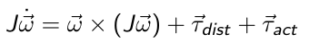
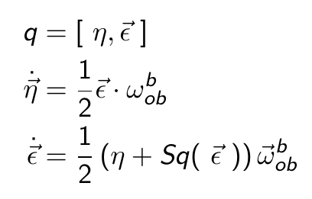
Rotational Dynamics
Rotational Dynamics and Kinematics
Dynamics.
Euler Equations
Kinematics
Quaternions
Why quaternions?
Euler angles / Roll – Pitch – Yaw may produce singularities when calculating Rotation Matrix

Slide 5
Orbital Dynamics
Short time Scale
No need for precision in position
Assumed circular orbit
Constant orbit angular velocity
Specified Argument of Periapsis and True Anomaly

Slide 6
Reference
Two reference quaternions
Zenith / Nadir Pointing
Sun Pointing (Inertial reference frame)
%% Picture of reference frames %%

Slide 7
Wave – Based Control
Launch a Wave
Absorb the returning wave
Reject disturbances

Slide 8
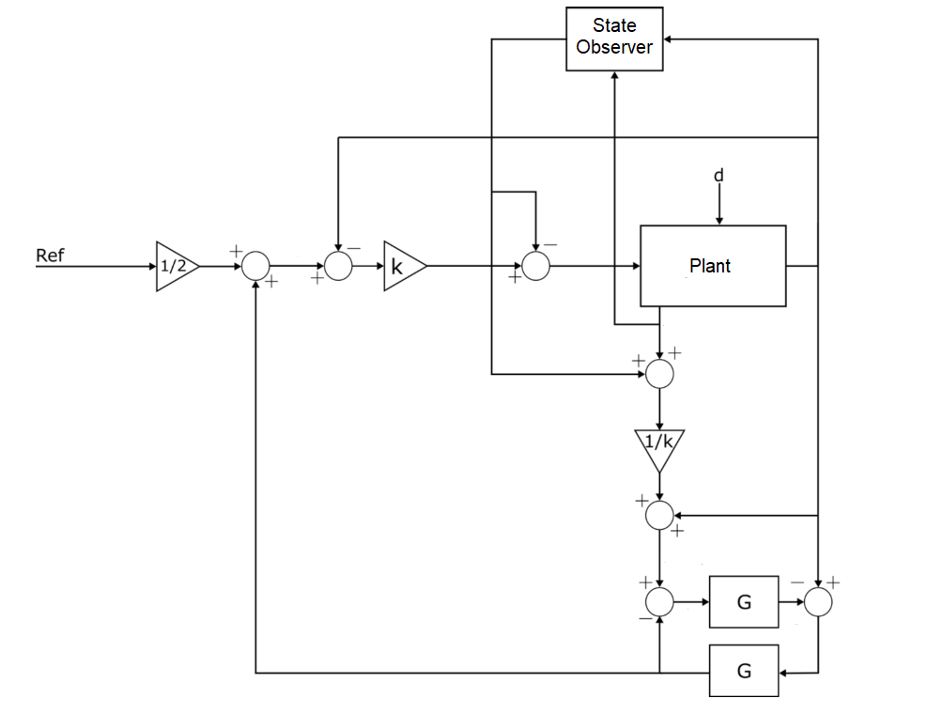
Wave – Based Control
Launch a Wave
Absorb the returning wave
Reject disturbances

Slide 9
Mode selection
Detumbling
[…]
Zenith / Nadir Pointing
[…]
Sun pointing
[…]

Slide 10
Sensors
Clyde Space Board
Magnetometer
IMU
GPS
Coarse Sun Sensor

Slide 11
Sensors
Delay
[…]
Noise
[…]
State Estimation (?). Extended / Unscendent Kalman Filters

Slide 12
Disturbances
Aerodynamic drag
Gravity gradient
Solar radiation
Internal magnetic Dipole

Slide 13
Solver
Runge Kutta 4 / 6
Variable step
Handled automatically by Simulink

Slide 14
Limitations and Improvements
Standardized Frame transformations
Full documentation
Third – Body Forces

Slide 15
Hardware. Clyde Space Board
%% Technical specifications from manual %%

Slide 16
Hardware. Clyde Space Board
%% Technical specifications from manual %%

Slide 17
OrbSim: Overview
Set of C libraries, incorporating multiple standard packages, to carry out simulation, Python scripts for plotting and data analysis.
Features require a version of C no older than C99.
Developed on Windows using MinGW environment.
Intended to be compatible with different OS’s
No use of multi-threading
Shouldn’t require changes to path/environment variables

Slide 18
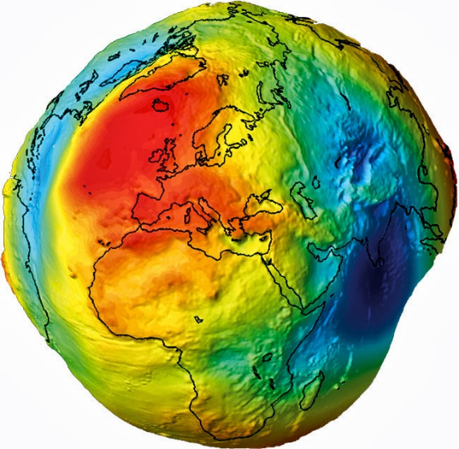
OrbSim: Overview
Second-order Ordinary Differential Equation solver
Runge-Kutta 6 for higher accuracy
Runge-Kutta 4 available for more rapid testing
Fixed time-step of 30s
Force model consists of
Earth’s point mass gravitational field
Spherical harmonic corrections (EGM08 model)
Drag force (NRLMSISE-00 model)
Sun, Moon third-body perturbations
Solar Radiation Pressure
Satellite rotation modelled using quaternions

Slide 19
OrbSim: Overview
Multiple custom structs
Cartesian state vector
Reference frame (Satellite-centered frame)
Space-weather entry
Satellite
Most ephemerides, frame transformations, coordinate conversions, etc. handled by the NAIF SPICE Toolkit
Positions of other bodies in the Solar System
Inertial (J2000), body-fixed (ITRF93) frame conversions
Geodetic coordinates (latitude, longitude)
Orbital Elements

Slide 20
OrbSim: Issues
Built on code with very different focus
Has required multiple iterations, currently on OrbSim v3.
Limitations to standard tools, SPICE in particular
Transformation of acceleration vector
Trial-and-error solution found
Older version of SPICE missing some useful features
Will be corrected in the future when there’s time
Orbital elements known to be unsuitable for high-accuracy work
Primary calculations done using Cartesian state vector
Inefficiency still an issue
To be corrected in the future

Slide 21
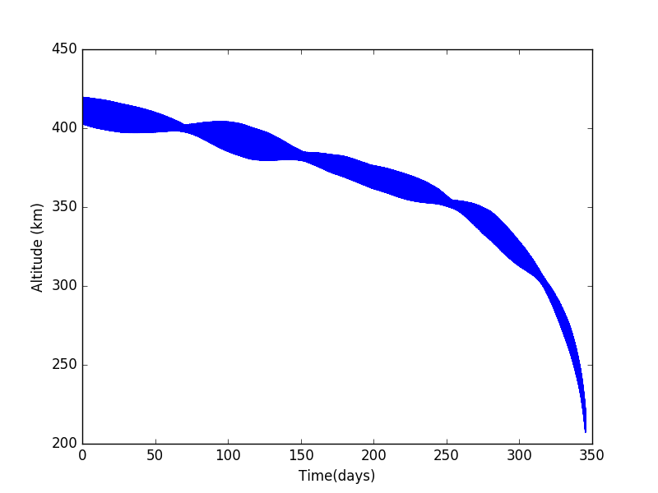
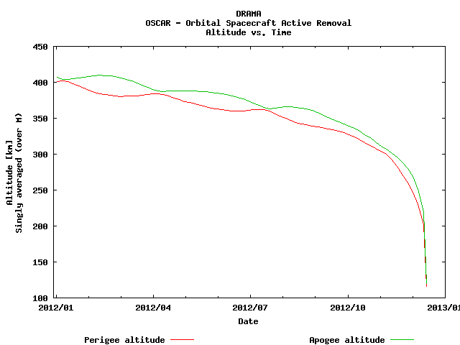
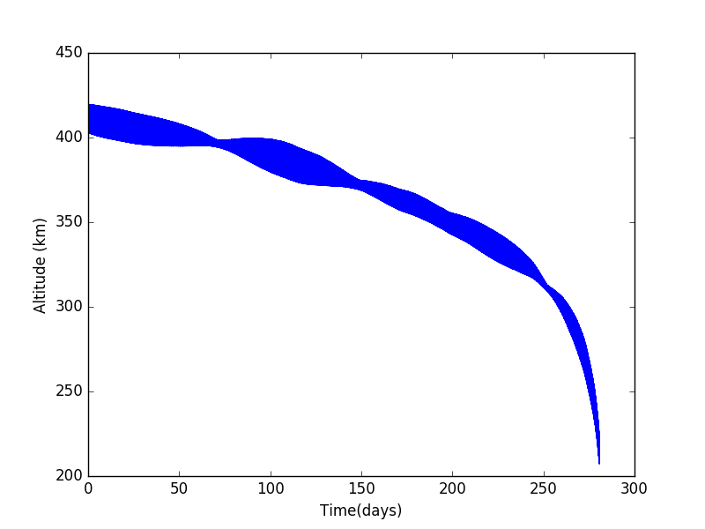
OrbSim: Current State
De-orbit prediction (w/o rotation)
within one day of ESA’s software
(345 days).
Satellite rotation accounted for
(zenith pointing for now) (280 days)

Slide 22
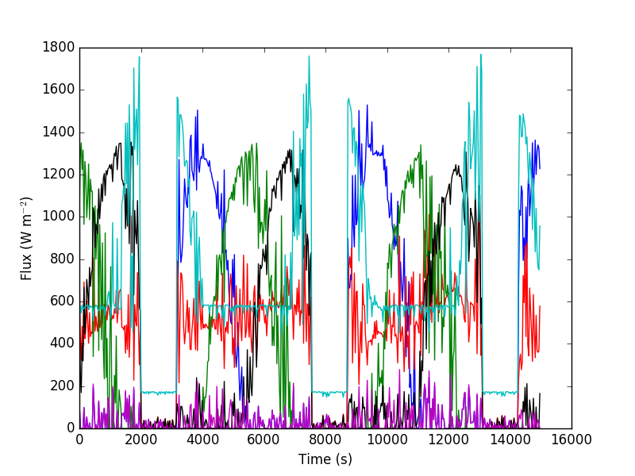
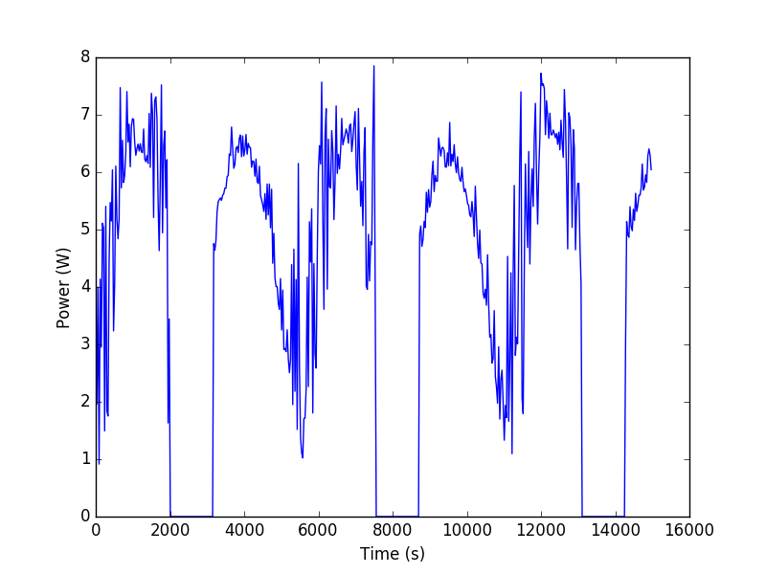
OrbSim: Current State
Thermal Model generated
Still some de-bugging required
Minor issue with satellite
rotation
Power generation from solar panels
Still some de-bugging required
Accurate figures from solar panel
specs needed.

Slide 23
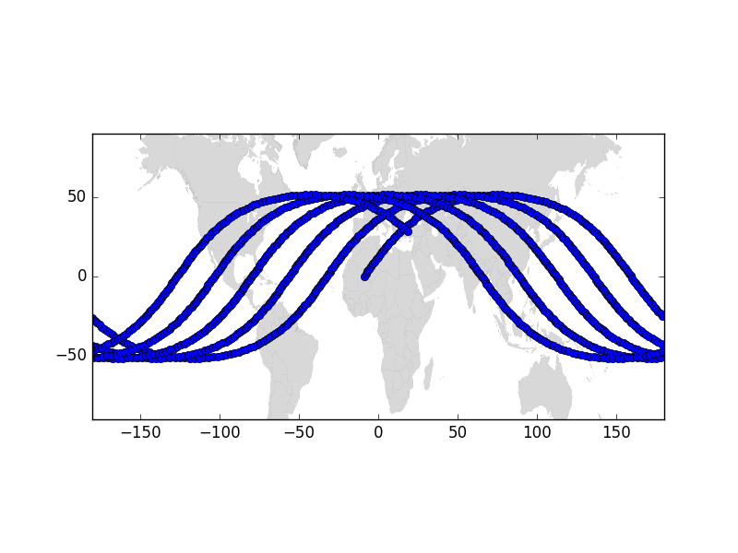
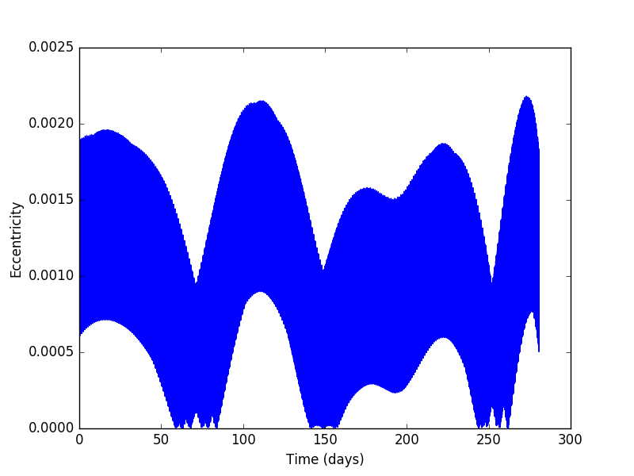
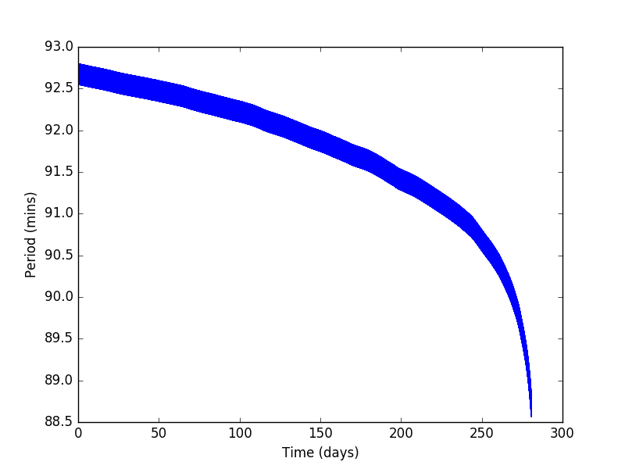
OrbSim: Current State
Ground track
Orbital Elements

Slide 24
Going Forward
Last major features to be added
Radiation dosage
Best/worst case scenarios for drag force
Make initial setup easier and more user friendly
Fully comment code
Collate python scripts into one Post-Processing.py
Options and setup files, which will allow the user to run code on different scenarios without recompilation
Upload to Github
Continue to work on improving efficiency

Slide 25
Going Forward
Many extra features which would be nice to have
Adaptive step-size functionality for ODE solver
Communications with ground station
Expansion to non-elliptical orbits (can solve for them, but orbital elements conversion not well-defined)
Error Analysis
Addition of magnetic field effects to force model
Generalize orientation calculation(s)
Addition of operations
Commands which would be passed to satellite in reality (eg. deployment of additional solar panels, re-orientation, etc.)
Generalization to larger-scale missions?
Orbital manoeuvres, launchers, etc.
GUI?

Slide 26
Going Forward
MASTER/DRAMA
On-orbit collision risk assessment
Re-entry risk assessment
Will EIRSAT-1 burn up on re-entry?
Does it pose a risk to human life?
Accidental break-up risk
Sanity check for results of OrbSim

Slide 27
Thank you
Any Questions?

